Slide 1
CSOM and REST
Name
Title
Company

Slide 2
Agenda
The SharePoint 2013 Strategy for CSOM and REST
Programming CSOM with C# and JavaScript
REST and ODATA Fundamentals
Making REST calls with C# and JavaScript

Slide 3
The SharePoint 2013 Strategy for CSOM and REST

Slide 4
CSOM in SharePoint 2010
CSOM Made Accessible through client.svc
SharePoint 2010 doesn't support direct access to client.svc
Calls to client.svc must go through supported entry points
Supported entry points are .NET, Silverlight and JavaScript
Managed CSOM easier to use than from JavaScript
JavaScript-driven CSOM hard to use and more limited
Notes:
The SharePoint client-side object model (CSOM) debuted in SharePoint 2010 where it was made available a WFC entry point named client.svc. However, SharePoint 2010 does not support developers accessing client.svc directly. Instead, the developer uses client-side proxy objects exposed by either a .NET assembly or a JavaScript library.
It is fair to say that the CSOM is easier to program against from managed code (i.e. C# and VB.NET) than from JavaScript. That’s because managed code programs against a strongly-typed object model and you experience compile-time type checking and much higher levels of IntelliSense. While you can also write CSOM code using JavaScript behind pages in a SharePoint 2010 site, the code is harder to write and debug because there is not compile-time type checking and IntelliSense is nowhere near as rich.

Slide 5
SharePoint 2010 CSOM
_vti_bin/client.svc
Server
Execute Query
Client
.NET Library
Silverlight Library
JavaScript Library
Custom Client Code
Notes:
This architectural diagram shows how client-side code uses the CSOM in SharePoint 2010.
.NET Clients program against proxy classes in Microsoft.SharePoint.Client.dll.
Silverlight clients program against proxy classes in Microsoft.SharePoint.Client.Silverlight.dll.
JavaScript clients program against proxy objects accessible through the JavaScript library sp.js.
In all three cases, the proxies conduct all the communications with the entry point on the Web server which is client.svc.

Slide 6
Changes in SharePoint 2013
The client.svc service extended with REST capabilities
client.svc now supports direct access from REST clients
client.svc accepts HTTP GET, PUT, POST requests
Implemented in accordance with OData protocol
CSOM Extended new APIs
New APIs for SharePoint Server functionality
New API for Windows Phone Applications
Notes:
One of the most significant changes in SharePoint 2013 is that the Web service entry point of client.svc service has been extended to allow for direct access via REST-based Web service calls. This is a big change because it makes the SharePoint platform accessible to just about any other platform and any type of device.
A significant portion of the REST-based access in SharePoint 2010 has been designed and implemented in accordance with the OData protocol. This means developers can access SharePoint content from across the Internet using one of today's most popular standards. If you do not already know about OData concepts and how to program against it, this is something you want to get up to speed on for the 2013 SharePoint product lifecycle.

Slide 7
What is covered in the new CSOM?
New APIs with SharePoint Server functionality
User Profiles
Search
Taxonomy
Feeds
Publishing
Sharing
Workflow
E-Discovery
IRM
Analytics
Business Data
Notes:
This slide above lists new areas in the SharePoint 2013 remote API that are accessible through both CSOM and REST. This is a welcome change because most of this functionality is only available through server-side APIs in a SharePoint 2010 farm. You can also see adding this remote access is very important to the new app model where developers can no longer run code in a SharePoint environment not can they access the server-side APIs.

Slide 8
SharePoint 2013 Remote API
_api is new alias for _vti_bin/client.svc
Server
Execute Query
Client
OData
JavaScript Library
Silverlight Library
.Net CLR Library
Custom Client Code
Notes:
This architectural diagram shows how things have changed in SharePoint 2013. client-side code uses the CSOM in SharePoint 2010. The major changes include:
You can substitute the alias _api in order to reference _vti_bin/client.svc
Client code can access client.svc directly using REST-based HTTP requests.
Much of the REST-based API is based on the OData protocol.
Code which uses the CSOM in SharePoint 2010 should migrate to SharePoint 2013 without any problems. However, when migrating from SharePoint 2013, there is quite a bit of SharePoint Server functionality that was not available in the previous version.

Slide 9
What About ListData.svc?
ListData.svc carried over from SharePoint 2010
Use REST CSOM when writing JavaScript
ListData.svc still available for migrated client applications
Notes:
In SharePoint 2010, the product provided OData support through the Web server entry point ListData.svc. The ListData.svc Web service is available in SharePoint 2013. However, you should understand that it is mainly proved for backwards compatibility for older clients that are migrating to SharePoint 2013. When creating new projects for SharePoint 2013 and later, you should not be using ListData.svc. Instead, you should be using the newer remote APIs with OData support that are discussed later in this module.

Slide 10
Programming CSOM with C# and JavaScript

Slide 11
Programming using CSOM
Your JavaScript Code
JSON Response
Client.svc
Server OM
JavaScript OM
XML Request
Browser
Proxy
Managed Client
XML Request
Proxy
Content database
Managed OM
JSON Response
Your C# and VB.NET Code
SharePoint Server
Notes:
There are three different entry points you can use to program against the CSOM.
.NET Applications
Silverlight Applications
JavaScript code
.NET applications and Silverlight applications program against class in an assembly while JavaScript code programs against JavaScript objects made accessible through sp.js. In all three cases the programmer is shield from having to send and receive WFC messages are they are sent to the Web server.

Slide 12
Changes to CSOM
In SharePoint Foundation
No Significant Changes to CSOM apart from REST support
Primary investment is adding REST support to existing API
In SharePoint Server
New APIs have been added with CSOM and REST support
Notes:
The primary enhancement to the CSOM for SharePoint Foundation is that the majority of it functionality has now also been exposed to Web service clients making REST calls across the network. This makes it easier to program JavaScript behind Web pages and it opens to doors to client applications that do not run using the .NET framework.
While SharePoint foundation does not expand its CSOM functionality, many of the SharePoint server services that did not expose Web service entry points in SharePoint 2010 now do in SharePoint 203. Some examples are Web services exposed for document management, WCM, terms and term sets and user profiles. You should also note that most (but not all) new CSOM functionality introduced in SharePoint Server 2013 is also mirrored with REST-based entry points as well.

Slide 13
CSOM using Managed Code
Notes:
The slide shows an example of CSOM code which accomplishes the following:
Establishes a connection to the SharePoint farm using default credentials
Retrieves information about the current site
Creates a new Contacts list
Retrieves and display information about the lists in the current site

Slide 14
CSOM using JavaScript
Notes:
This slides shows a typical example using the CSOM from JavaScript behind a page in a SharePoint 2013 site. This code also leverages jQuery and in particular the document ready function to execute the onPageLoad function when the DOM is ready to access. Note how this code calls ExecuteOrDelayUntilScriptLoaded to force the download of sp.js before executing the initializeCSOM function. This is a common practice to ensure that that CSOM is available for use before you begin to program against it.

Slide 15
Programming CSOM from a C# Project
demo

Slide 16
REST and ODATA Fundamentals

Slide 17
Why is REST Important?
Significant Industry Momentum
Simpler and Easier to Use
Much easier to use than SOAP-based Web service
Higher productivity when using JavaScript and jQuery
Results can be returned in JSON and ATOM format
Each query is submitted with a unique URL
Results can be cached by proxy servers
Notes:
Over the last few years REST-based Web services have become increasing popular through the IT industry and particularly within Microsoft. REST-based Web services are much easier to use than SOAP-based Web service and therefore lower the barrier of entry to different types of potential clients. REST-based Web services are also much easier to call from JavaScript code especially when using the jQuery library.

Slide 18
ODATA Primer
“THE” New Data Access API for HTTP-based Clients
Based on open specification growing in popularity
Standardizes Data Access APIs for CRUD operations
OData services are emerging on Internet (NetFlix, Dallas, Azure)
OData clients becoming more popular as well
Notes:
OData is quickly becoming the industry’s new data access API. It’s popularity is based on the fact that it is the first mainstream data access API for HTTP-based Clients. OData serves to standardize performing CRUD (Create, Read, Update, Delete) operations from across the network using HTTP verbs such as GET, PUT and POST.
OData services are becoming more popular on the Internet. Examples of OData services include NetFlix, Dallas, and the Azure Data Mart. Client application such as Excel 2010 and Excel 2013 are examples of client application that can consume data from any OData-based data source.

Slide 19
OData Terms and Concepts
Odata Resource | Is Described in an Entity Data Model by
Collection | Entity Set A navigation property on an entity type that identifies a collection of entities
Entry | Entity Type Note: Entity Types may be part of a type hierarchy
Property of an entry | Primitive or Complex Entity Type Property
Complex Type | Complex Type
Link | A Navigation Property defined on an Entity Type
Service Operation | Function Import
Notes:
This slides lists and describes a few of the most important terms you will encounter when starting the learn how OData works.

Slide 20
OData Implementation Details
OData maps CRUD operations to HTTP verbs
Read operations mapped to HTTP GET
Insert operations mapped to HTP POST
Update operations mapped to HTTP PUT or HTTP MERGE
Delete operations mapped to HTTP DELETE
Methods will be mapped into either…
Navigator operations (e.g., web.getByTitle) via a GET
Service operations via a POST, PUT, MERGE or DELETE
Notes:
The primary purpose of OData is to map CRUD operations to HTTP verbs. For example, you can query data using an HTTP GET. You can add new entries (e.g. list items, database records) using an HTP POST. Updates are performed using either an HTTP PUT or an HTTP MERGE. You can delete entries using an HTTP DELETE.
The advantage of the HTTP Merge over the HTTP PUT for updates is that you can update some columns while leaving others with their original value. Updating an entry with HTTP PUT operation will reset any column not explicitly assigned a value back to the default value.

Slide 21
OData URIs
URI has three significant parts
Service root URI
Resource path
Query string options
Notes:
To understand how to use OData as a developer, you must understand how OData URIs are constructed. Each URI has three significant parts, The first part of the URI is the Service root URI which points to a site on the Internet and a path to an entry point such as a .svc file. The next part of the URI is the Resource path which identifies a specific object such as a site, a collection (e.g list) or an entry (e.g. item). The final part of the URI are the optional query string parameters that allow you to request special processing instructions such as filtering and sorting.

Slide 22
REST URLs in SharePoint 2013
CSOM URLS can go through _api folder
Simplifies URLs that need to be built
Removes client.svc file name from URL
You can replace this URL
http://contososerver/_vti_bin/client.svc/web
With this URL
http://contososerver/_api/web
Notes:
In SharePoint 2013 the Service root URI contains the URI to the target SharePoint site and then the relative path to the client.svc entry point inside the _vti_bin virtual directory. After that you add the resource path to specify an object such as a site or list. Here's an example of a resource path for the current site.
http://contososerver/_vti_bin/client.svc/web
SharePoint 2013 allows REST URLS can go through _api folder which cleans up the look of the URLs that need to be built and removes client.svc file name from URL. The URL below is equivalent to the one above and should be preferred.
http://contososerver/_api/web

Slide 23
Mapping Objects to Resources
Example REST URLs targeting SharePoint sites
_api/web/lists
_api/web/lists/getByTitle('Announcements')
_api/web/getAvailableWebTemplates(lcid=1033)
Notes:
This slides shows example URIs.
The the collection of lists for the current site
_api/web/lists
Get a specific list by its title
_api/web/lists/getByTitle('Announcements')
Get all the Web templates within the current site which as based on US English
_api/web/getAvailableWebTemplates(lcid=1033)

Slide 24
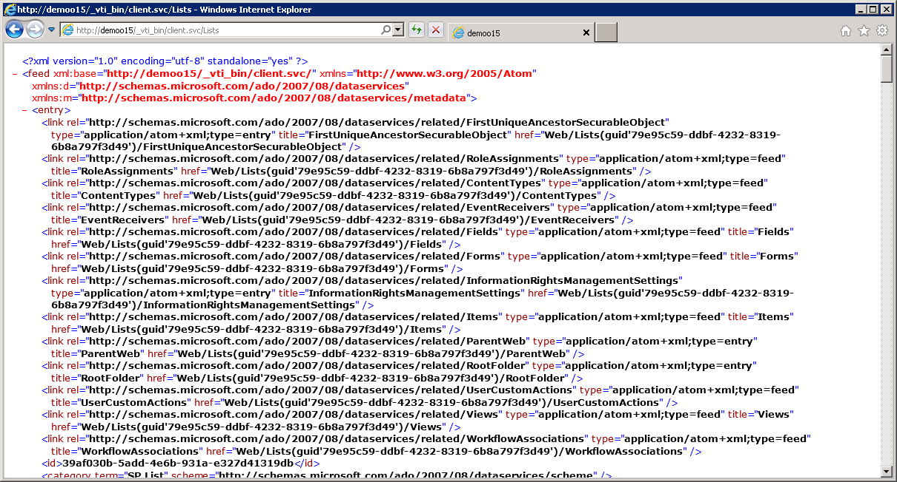
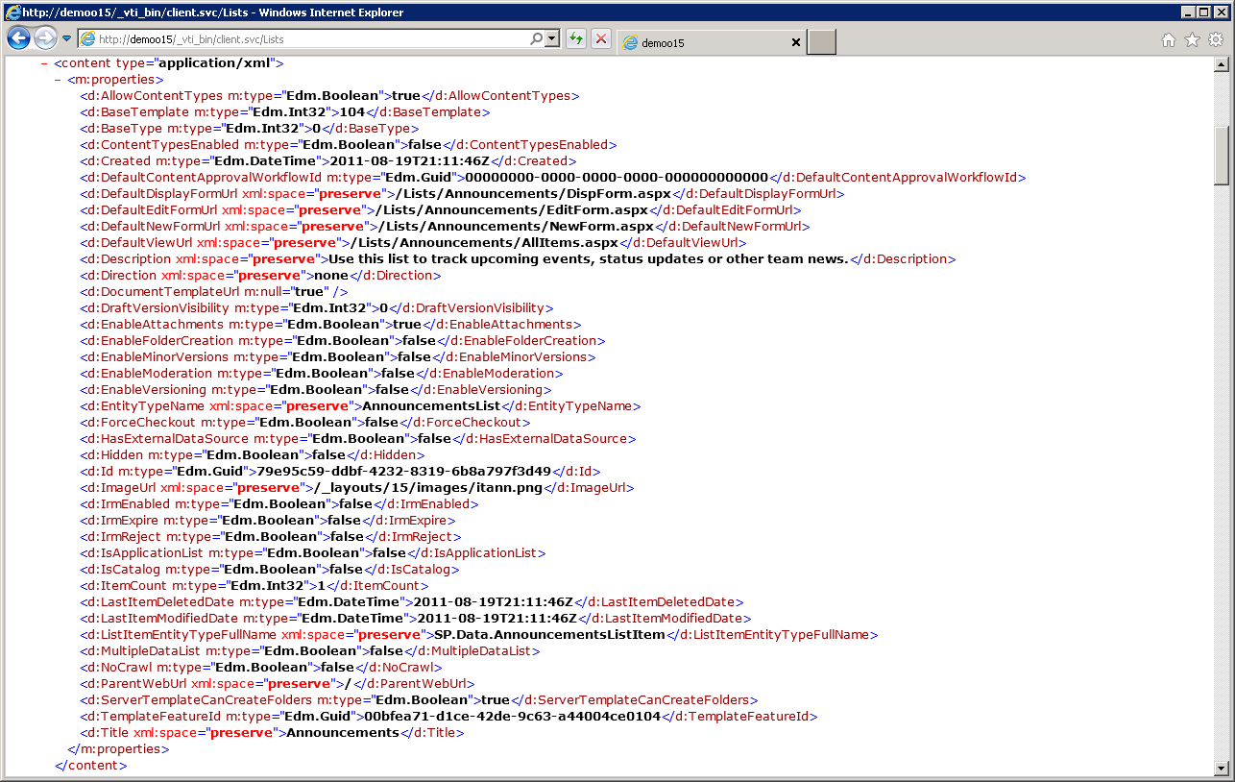
Testing REST Calls Through the Browser
Notes:
One of the best parts of REST is that it simplifies calling Web service operations. All you need is a browser that can authenticate against a SharePoint 2013 site and you can simply run queries by typing the REST-based URIs for HTTP GET operations. This becomes a fast and easy way for you to learn how to put together URIs that query, filter and sort content from SharePoint sites.

Slide 25
Executing REST Queries Through The Browser
demo

Slide 26
Making REST calls with C# and JavaScript

Slide 27
Returning ATOM XML vs. JSON
Response data format selected with ACCEPT header
XML can be easier to deal with from managed code
To get ATOM XML response use "application/atom+xml"
JSON is easier to deal with when using JavaScript
To get JSON response use "application/json;odata=verbose"
Notes:
When you run REST-based queries against SharePoint 2013 sites, you have the option of having the data returned as either XML in the ATOM format or JSON (JavaScript Object Notation). The default behavior is to return XML but you can change this default behavior to return JSON by including the ACCEPT header with a value of "application/json". If you include the ACCEPT header with an explicit value of "application/atom+xml", this has the same result as the default behavior in that the results are returned as ATOM-based XML.
As a general rule of thumb, it is easier to deal with XML-based results when writing managed code such as C# or VB.NET. Likewise, it is easier to deal with JSON results when programming with JavaScript. Note that jQuery makes dealing with JSON results even easier.

Slide 28
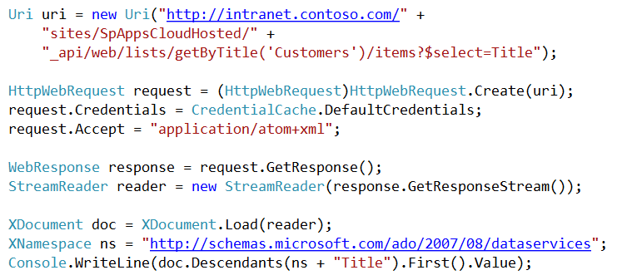
REST Query from Managed Code
Tips for making REST calls from managed code
Use the HttpWebRequest and HttpWebResponse objects
Query XML using XDocument.Descendants
Notes:
If you are making REST calls into SharePoint 2013 using C# or VB.NET, there are a few tips to make things easier. First, .NET 4.0 added a two new classes named HttpWebRequest and HttpWebResponse which provide a few conveniences not offered by their base classes WebRequest and WebResponse. For example, there is a stongly-typed Accept property on the HttpWebRequest object that allows you to set the ACCEPT header.
When it's time to retrieve data values from elements within an XML document, it's time to abandon older XML APIs such as XMLReader in favor of Linq to XML and the XDocument class. Retrieving data from an XML document using the Descendants property of an XDocument object as shown above makes dealing with nested elements and XML namespaces so much easier.

Slide 29
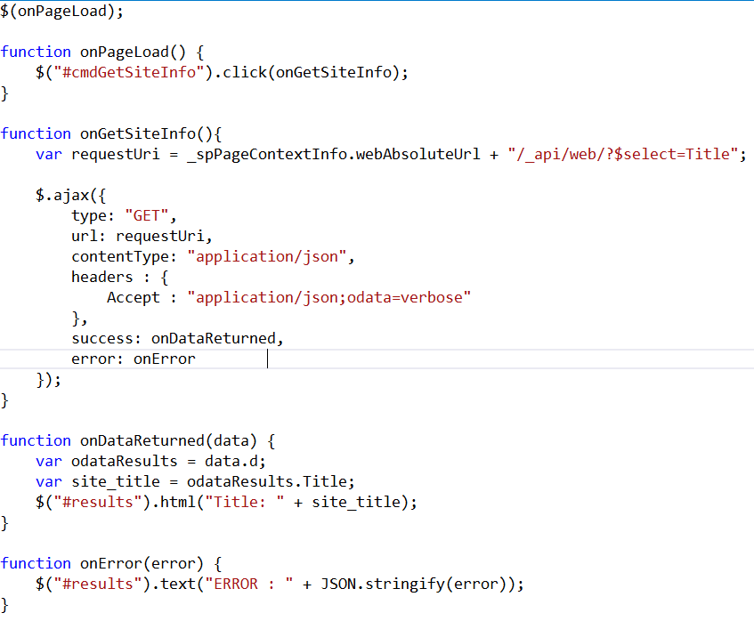
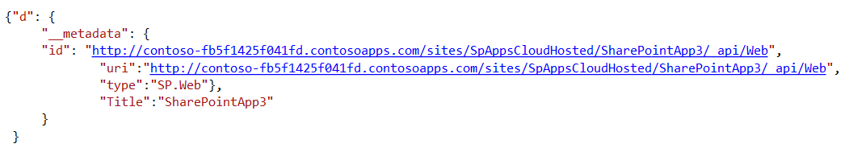
REST Query Using JavaScript & jQuery
Notes:
If you are executing REST-based queries against SharePoint 2013 sites using JavaScript, the first piece of advice is to use jQuery because it simples returning and processing JSON result sets. The code above uses the jQuery function $.getJSON which automatically sets the ACCEPT header to return a JSON result set. When jQuery calls the callback method (OnDataReturned in this example) it passes a data parameter which represents that JSON results set which has already been converted from a string into JavaScript objects.

Slide 30
Creating Templates using jsRender
jsRender library provides template-based rendering
Works very well in combination with JSON collections
Use $.template to create a template
Use $.render to generate output from a JSON collection
Notes:
When dealing with JSON result sets, it is a common practice to parse together HTML elements to update the current page. The jsRender library created by Boris Moore is a very useful utility library because it allows you to construct complex HTML elements using a special syntax for creating templates. More information on this library can be found at the following URL:
https://github.com/BorisMoore/jsrender
You can also ready about using jsRender in these two MSDN articles by Jonny Popa
http://msdn.microsoft.com/en-us/magazine/hh882454.aspx
http://msdn.microsoft.com/en-us/magazine/hh975379.aspx

Slide 31
Updates and the Form Digest
Updates using REST require Form Digest
Form Digest is a special value created using cryptography
Form Digest is used to protect against replay attack
SharePoint pages have control holding Form Digest
Web service clients must acquire Form Digest separately
Form Digest can be acquired through _vti_bin/sites.asmx or _api/contextinfo
Notes:
One thing that can be tricky is understanding the purpose of the Form Digest control. The purpose of this control is that it protects SharePoint against replay attacks. The Form Digest control does this by using cryptography to create a special value that is passed to the client browser. This value must be passed back to SharePoint and validated on requests that update objects or content within a SharePoint site. In many scenarios everything is transparent because the Form Digest control is added to master pages and does all the required work behind the scenes. However, when making updates with CSOM and REST there is no page postback so the form digest cannot do all that is required by itself.
When writing JavaScript behind pages in a SharePoint 2013 site, you often will be required to query the value of the Form Digest control and pass it back in a named header. Web service clients often do not have a page associated with it so they have to obtain a Form Digest value by making an explicit call into SharePoint before making updates. Note that a Form Digest value can be acquired through the older SOAP Web service entry point _vti_bin/sites.asmx.
.

Slide 32
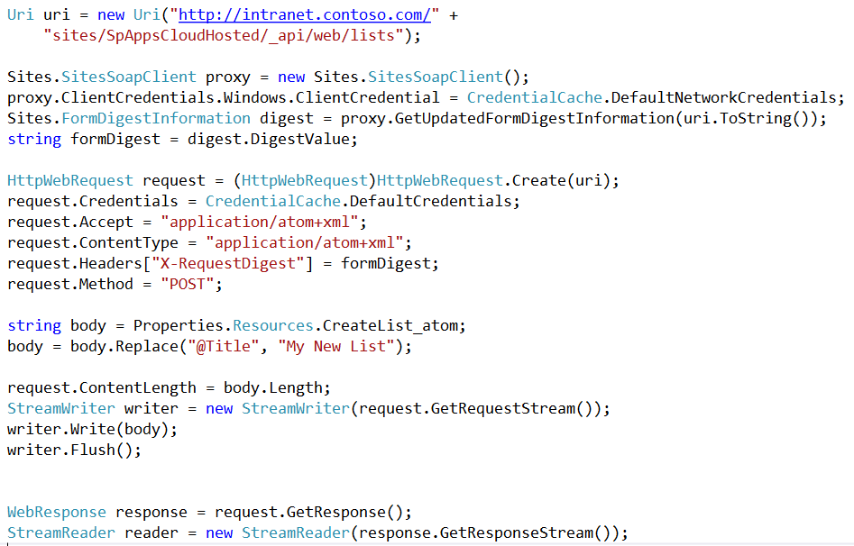
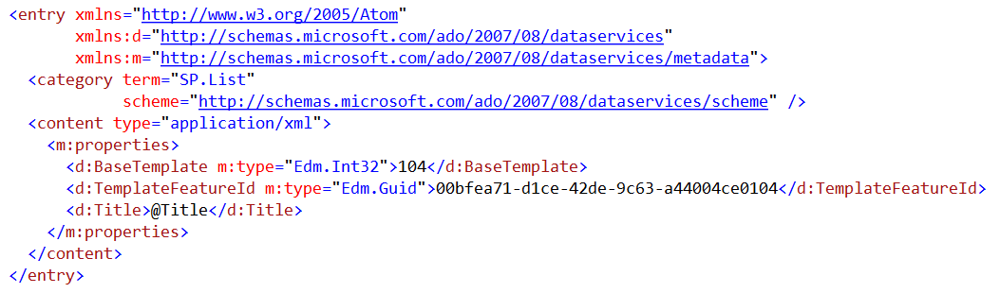
Creating Lists with Managed Code
Steps when creating a new list using the REST API
Parse together URL to point to lists collection
Add X-RequestDigest header which includes value of form digest
Set HTTP method to POST
Create body content with new list info
Notes:
This slide shows the code which demonstrates creating a new list using client-side C# code which uses the new REST entry point. The first task it to parse together URL to point to lists collection which is _api/web/lists. The next task is to add the X-RequestDigest header which includes the value of the form digest. This example also sets the ContentType header to a value of application/atom+xml to tell SharePoint it is passing XML as opposed to JSON. Next, you must create an XML document that contains an Entry as defined by ATOM and conforms to the structure used by SharePoint 2013. The last task is to execute the request using an HTTP POST operation.

Slide 33
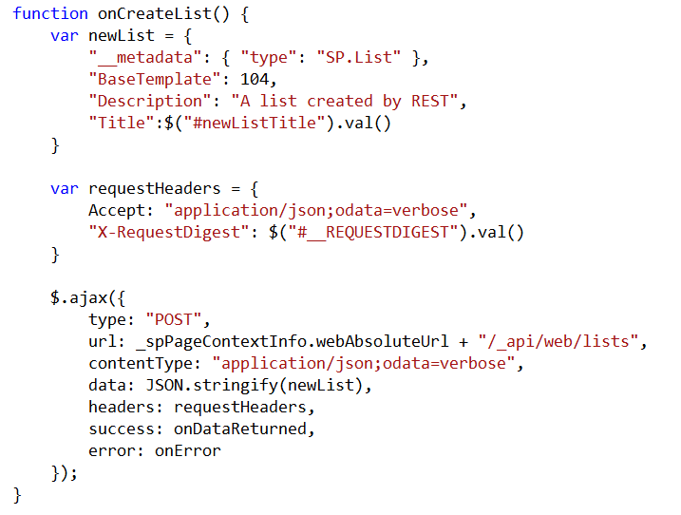
Creating Lists with JavaScript and jQuery
Create appropriate JavaScript object and convert to JSON format for request body
Create request headers for HTTP Request
Get form digest value from control on page
Send request to Web server using jQuery $.ajax function
Convert request body data to string-based JSON object
Notes:
This code demonstrates how to create a new list using JavaScript and the jQuery library. Note that this is different from the previous example using C# because the entry is created using JSON instead of XML. Note that the code queries the value of the form digest control with the standard name of __REQUESTDIGEST and adds the value to the X-RequestDigest header. Also note that the $.ajax function can be used to execute the required HTTP POST operation which creates the list.

Slide 34
Querying and Updating Content Using REST
demo

Slide 35
Summary
The SharePoint 2013 Strategy for CSOM and REST
Programming CSOM with C# and JavaScript
REST and ODATA Fundamentals
Making REST calls with C# and JavaScript

Slide 36
Q&A

Slide 37

© 2012 Microsoft Corporation. All rights reserved. Microsoft, Windows, Windows Vista and other product names are or may be registered trademarks and/or trademarks in the U.S. and/or other countries.
The information herein is for informational purposes only and represents the current view of Microsoft Corporation as of the date of this presentation. Because Microsoft must respond to changing market conditions, it should not be interpreted to be a commitment on the part of Microsoft, and Microsoft cannot guarantee the accuracy of any information provided after the date of this presentation. MICROSOFT MAKES NO WARRANTIES, EXPRESS, IMPLIED OR STATUTORY, AS TO THE INFORMATION IN THIS PRESENTATION.

